Slide 1
Men’s Football Player Market Value Analysis and Prediction
By Matthew Hewitt
Notes:
Any questions will be taken at the end

Slide 2
CONTENTS OF THIS PRESENTATION
The Problem and Objectives
Exploratory Data Analysis
Data Preparation
Predictive Modelling
User Input Demonstration

Slide 3
The Problem and Objectives
What is the real world issue and how do I plan to help/resolve it.

Slide 4
The Problem
The men’s football transfer market is forever growing and hyperinflated place!
Fantastic for TV broadcasters, the players and venture capitalists, however…
Smaller and less wealthy clubs are falling behind and need to find a way to find value in an already inflated market.
Notes:
Forever growing and seemingly ludicrous place
Players are bought for excessive and inflated prices due to increasing influence of wealth in the game
Falling behind larger and wealthier clubs who can afford better resources, players and player wages

Slide 5
Objectives of Project
1
2
3
DATA ANALYSIS
PREDICTIVE MODEL
Small Demographic Analysis
Highlight players in the market who represent best value for money
USER INPUT
To find players of specific position, age and value
Notes:
1 - looking at MV by position age and nationality

Slide 6
THE DATABASE
Football Manager 2020
Unable to source desired/appropriate real world database
Opted for real world simulation game
Used by real world football clubs to scout players
Sampled top 5000 by overall rating
*https://afootballreport.com/blog/how-real-world-football-teams-use-football-manager
Notes:
Provided me with necessary data for this project

Slide 7
Exploratory Data Analysis
Demographic Analysis of Market Value
Notes:
Early EDA:
Most notable findings; positive skew of target variable, and strong correlations of planned feature variables

Slide 8
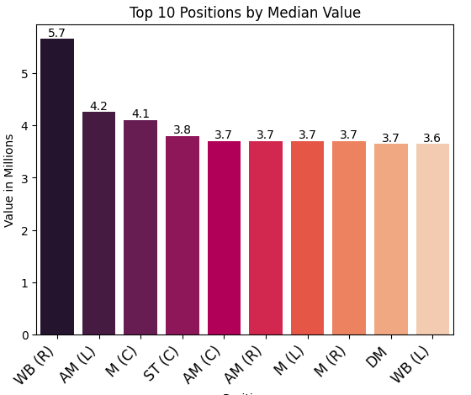
Market Value by Position
Attacking positions averaged highest value across dataset
WBR first?
Only 22 in dataset with a few high values. E.g €50m, €22m

Slide 9
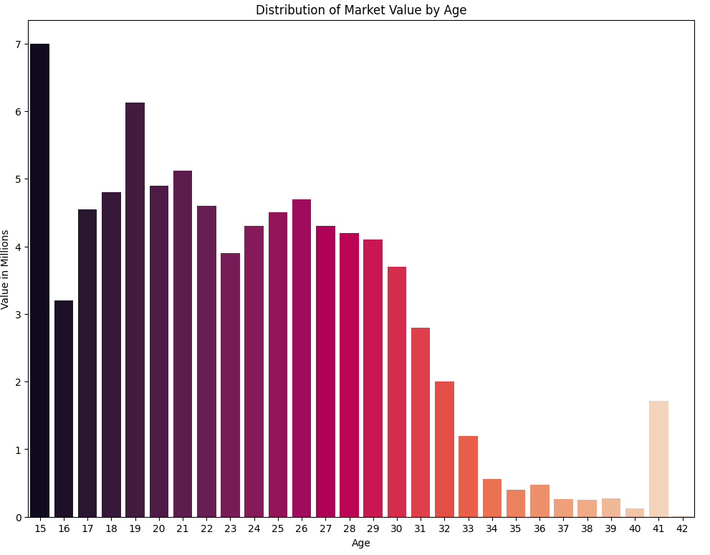
Distribution of Age by Market Value
Similar to how expected besides 15 years
One 15 year old (Jude Bellingham)

Slide 10
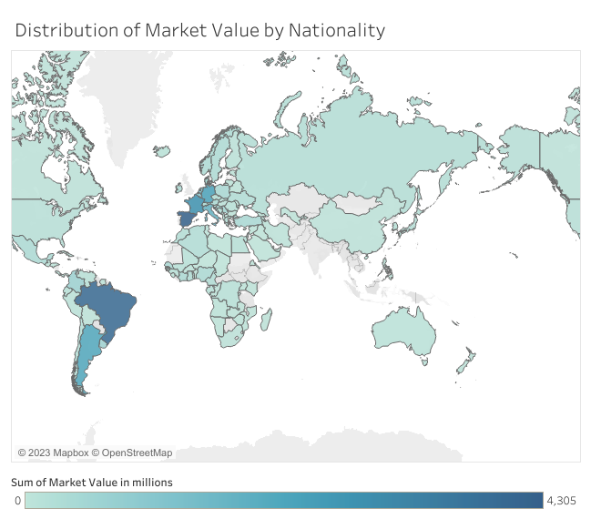
Market Value by Nationality
Notes:
UK - totalled 4500 million

Slide 11
DATA PREPARATION
Preparing data for modelling

Slide 12
4 STEPS OF DATA PREPARATION
COMBINING FEATURES
FEATURE SELECTION
MAPPING
TRANSFORMING TARGET
E.g - Dribbling, Flair and Vision became ‘Creativity’
Dropped unwanted features such as height and weight
Mapped one feature, but no nulls or duplicates
Square rooted Market Value to improve skew

Slide 13
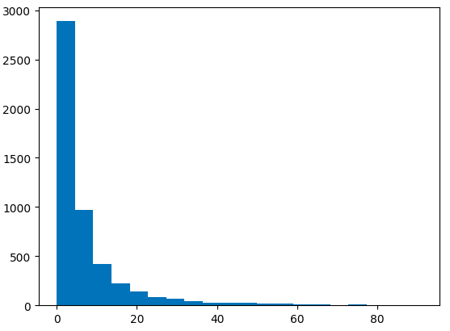
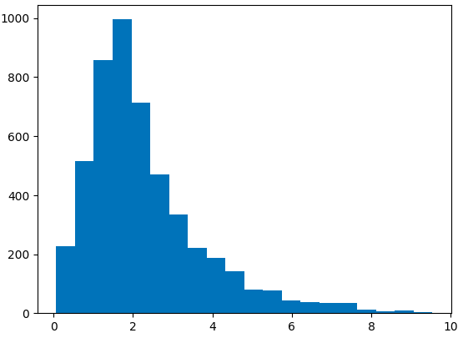
Market Value
Square Root Market Value

Slide 14

PREDICTIVE MODELLING
Predicting Market Value

Slide 15
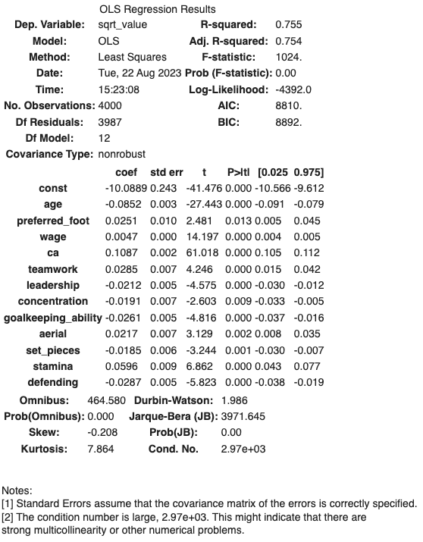
LINEAR REGRESSION MODEL
About 25% of the variability of the outcome cannot be explained by the model
Model fits the data it was generated from well
All features were significant to results
Back-transformed RMSE:
Train = €3.32m
Test = €3.19m
High multicollinearity - could be undermining the significance of variables

Slide 16
LASSO AND RIDGE REGRESSION MODELS
Lasso Regression
Coefficients determined in a linear model are penalised, resulting in less important features being eliminated
Ridge Regression
Similar to Lasso as applies a penalty to coefficients, however Ridge takes the square of coefficients, whilst Lasso takes the magnitude
Importance for this project: Ridge and Lasso Regression both can handle multicollinearity

Slide 17
WHICH MODEL PERFORMED BEST?
LINEAR REGRESSION
LASSO REGRESSION
RIDGE REGRESSION
RMSE Train = €3.32m
RMSE Test = €3.19m
RMSE Train = €3.34m
RMSE Test = €3.19
RMSE Train = €3.31m
RMSE Test = €3.2m

Slide 18
USER INPUT DEMO

Slide 19
IMPLICATIONS AND IMPROVEMENTS
SUMMARY
Gives teams with lower budgets an edge in market if they can be pointed towards players who have represent best value for money
Same idea but using real world data and statistics
Produce model showcasing the women’s game
Objective to do small demographic analysis of market value and provide predictive model for football clubs to use, to gain insight into players who provide the most value in an inflated market. The result was a strong model with an RMSE of €3m and a user input which can be used to specify, position, age and value.

Slide 20

THANK YOU FOR LISTENING!
Are there any questions?

